Slide 1
secure data hiding in images using steganography
CAPSTONE PROJECT
Presented By: Saritha Bhairi
Student Name : Saritha Bhairi
College Name & Department : Malla Reddy College of Engineering &Technology, Mechanical Department

Slide 2
OUTLINE
Problem Statement
Technology used
Wow factor
End users
Result
Conclusion
Git-hub Link
Future scope

Slide 3
Problem Statement
With the growing concerns around privacy and security, protecting sensitive information during transmission is crucial. Steganography, the practice of concealing data within other media, offers a solution by embedding secret data into images in a way that is undetectable to the human eye. The primary goal of this research is to explore a secure data hiding technique within digital images using steganography methods.

Slide 4
Technology used
Mention libraries
opencv-python:
OpenCV is a comprehensive computer vision library that also works for image manipulation and processing, making it useful for steganography, particularly when dealing with more complex image manipulations or video processing.
Installation: pip install opencv-python
Use case: Image analysis and manipulation, allowing you to integrate advanced techniques in steganography.
string:
os:
Mention Platforms
Google Colab:
A cloud-based platform that allows you to run Python code in a browser environment. Can be used to write and execute steganographic algorithms without needing to install anything locally.
Use case: Quickly testing and experimenting with steganography code, especially when working with images.

Slide 5
Wow factors
Least Significant Bit (LSB) Substitution
Advanced Pixel Manipulation
Color Channel Techniques
Using Image compression Technique

Slide 6
End users
End users of steganography tools and libraries, especially in the context of Python-based platforms, can be quite diverse depending on the specific use cases of steganography. Here are some examples of end users who might make use of steganographic techniques:
1. Security Professionals
2. Cybersecurity Enthusiasts and Hackers
3. Journalists and Whistleblowers
4. Digital Artists and Content Creators
5. Law Enforcement and Forensics
6. Educators and Students
7. Privacy Advocates and Activists
8. Companies and Organizations
9. Social Media Users
10. File Sharing Services

Slide 7
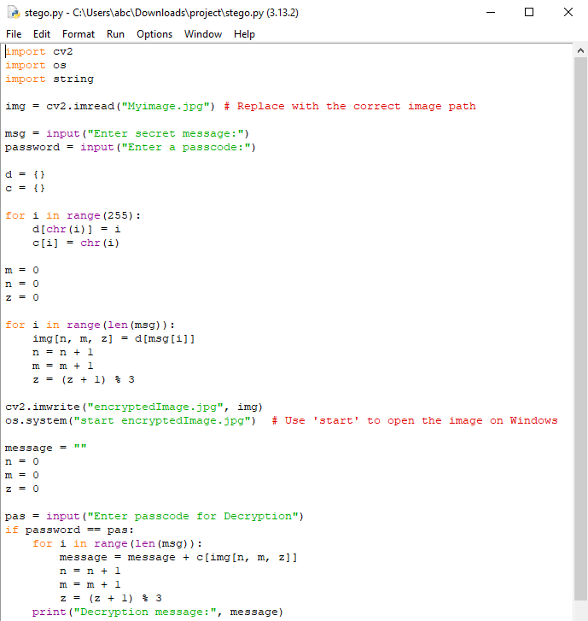
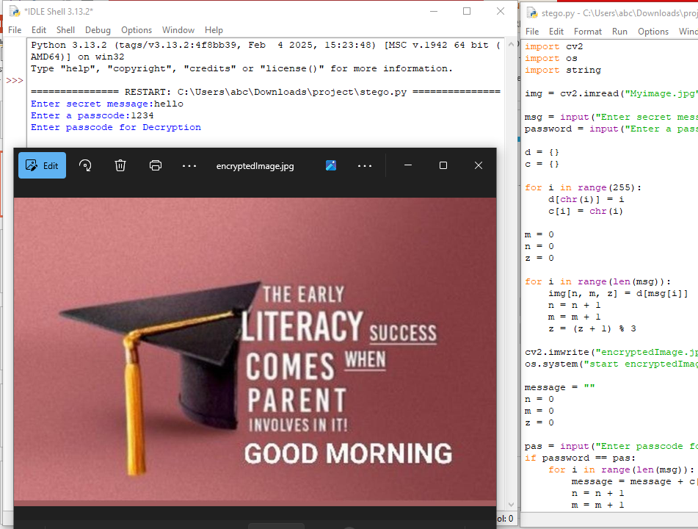
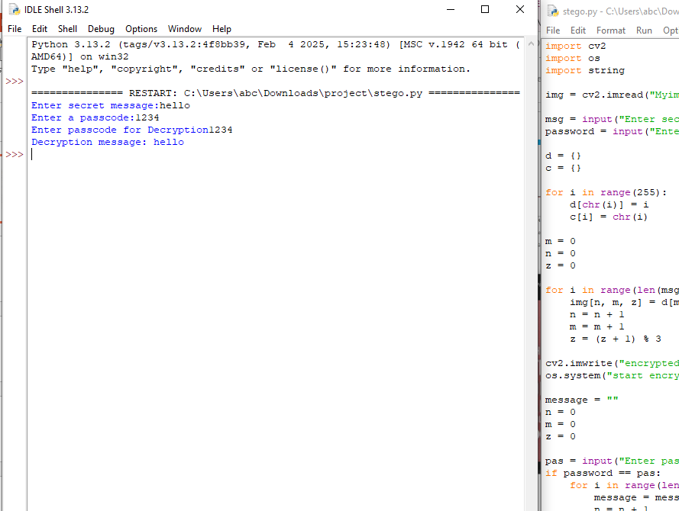
Results
Encryption
Decryption

Slide 8
Conclusion
Secure data hiding using steganography in images presents a sophisticated method for safeguarding information. When used correctly, it enables discreet communication, digital watermarking, and secure file transfers. However, as with any security method, it is important to stay updated on advancements in detection techniques and continuously refine methods to maintain security and stealth.
In conclusion, as digital communication continues to grow, steganography's role in enhancing privacy and security will remain essential. The continued research and development of more sophisticated and undetectable methods will ensure its place in the future of secure information exchange.

Slide 9
GitHub Link
https://github.com/SarithaPabolu/ProjectIBM.git

Slide 10
Future scope(optional)
The future of secure data hiding in images through steganography is exciting, with potential developments that promise to further enhance the security, efficiency, and versatility of these techniques. As privacy concerns grow and digital communication becomes more complex, steganography will continue to evolve, offering innovative solutions for secure data transmission.
By integrating advanced cryptographic methods, AI technologies, and multimedia platforms, steganography will become an essential tool for securing sensitive information in an increasingly connected and digital world.

Slide 11
THANK YOU

